Slide 1



Student-Centred Leadership:
An Evidence-Based Approach
Viviane Robinson
Academic Director,
University of Auckland Centre for Educational Leadership
Nanyang Girls High School

Slide 2
What is Student-Centred Leadership?
√
leadership that makes a difference to the equity and excellence of student outcomes

Slide 3

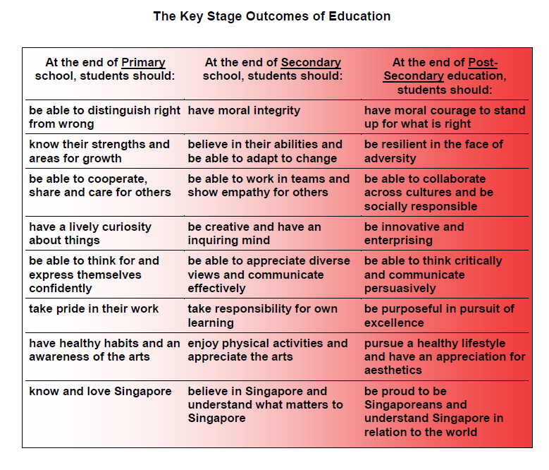
The Desired Outcomes of Education

Slide 4
The Ruler for Evaluating Leadership
We should judge leadership primarily by impact on students rather than on adults

Slide 5
The How and the What of Student-Centred Leadership
What do leaders need to do to have a bigger impact?
How do they do it?

Slide 6
Integrating educational knowledge into practice
Leadership capabilities
Solving complex problems
Building relational trust
High quality teaching and learning
Leadership dimensions
Establishing goals and expectations
Resourcing strategically
Ensuring quality teaching
Leading teacher learning and development
Ensuring an orderly and safe environment

Slide 7
Five Dimensions of Student-Centred Leadership
Derived from Quantitative Studies Linking Leadership with Student Outcomes
Establishing Goals and Expectations
Resourcing Strategically
Ensuring Quality Teaching
Leading Teacher Learning and Development
Ensuring an Orderly and Safe Environment
Notes:
Tell the story that makes the five dimensions hang together

Slide 8

The Big Message
The more leaders focus their relationships, their work and their learning on the core business of teaching and learning the greater their influence on student outcomes.

Slide 9
Exercise 1: Reflections on Five Dimensions
Were there any surprises in the research evidence about the effect of the different types of leadership?
Are there aspects of educational leadership that you think are important that are not included in the five dimensions or three capabilities?

Slide 10
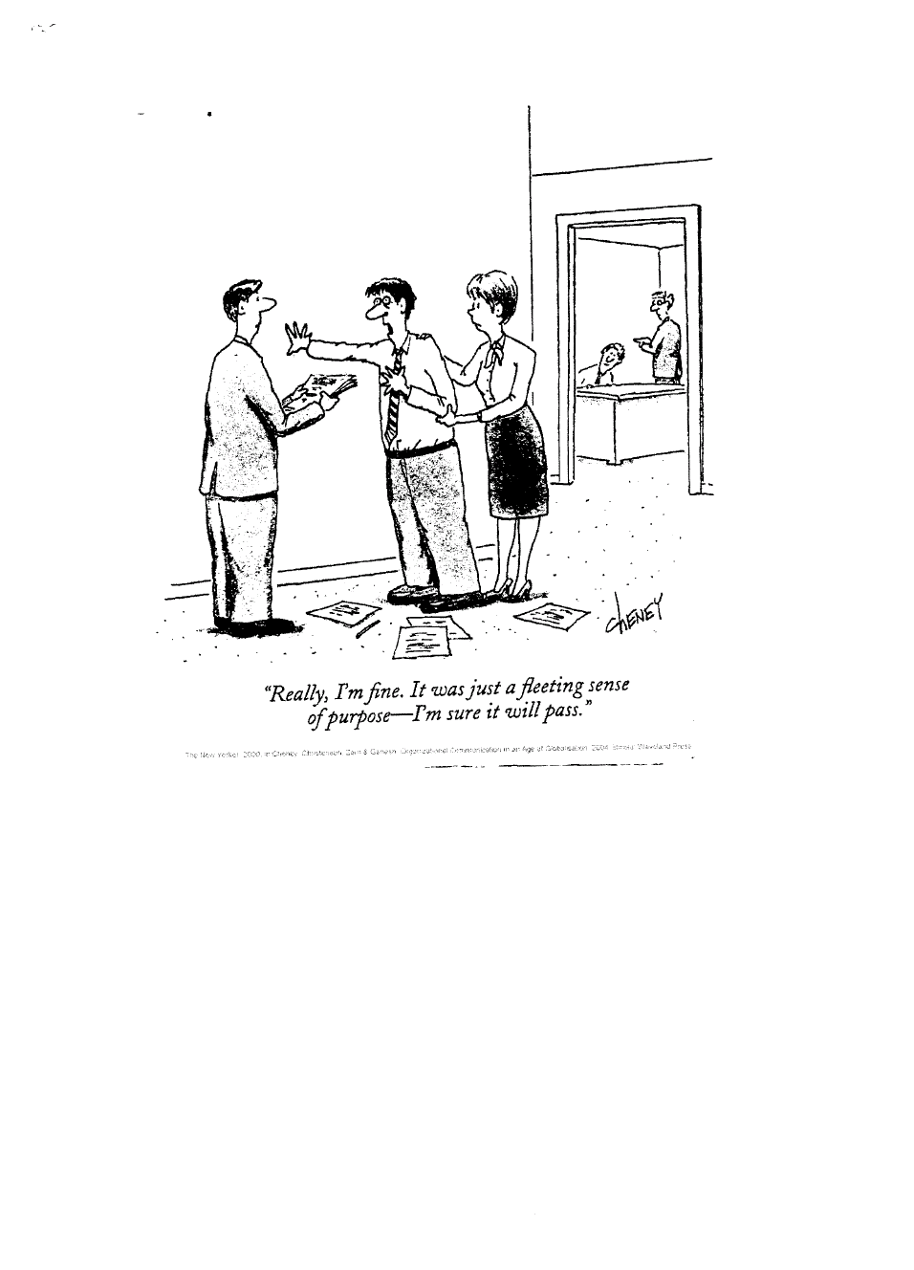
Student-Centred Leadership: Dimension One
1. Establishing Goals and Expectations
2. Resourcing Strategically
3. Ensuring Quality Teaching
4. Leading Teacher Learning and Development
5. Ensuring an Orderly and Safe Environment

Slide 11
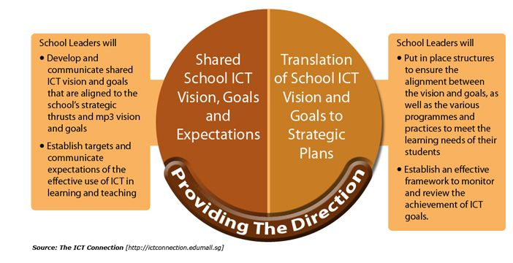
Masterplan 3
With strong school leadership in providing the direction for ICT use, there will be:
Shared school ICT vision, goals and expectations
Translation of school ICT vision and goals to strategic plans
Notes:
The key concept in the goal for school leaders is about the Principal playing the important role in providing the direction and creating the conditions for teachers and students to use ICT in a meaningful way.
With strong school leadership in providing the direction for ICT use, there will be:
Shared school ICT vision, goals and expectations
Translation of school ICT vision and goals to strategic plans

Slide 12
Exercise 2: What do you know about goal setting?
Write down in note form what you know about effective goal setting. What conditions are required for goal setting to be effective?

Slide 13
Aspects of Goal Setting
1. Establishing Goals and Expectations
includes:
setting
important and measurable learning goals
2. Resourcing Strategically
communicating
clearly to all relevant audiences
3. Ensuring Quality Teaching
involving
staff and others in the process
4. Leading Teacher Learning and Development
clarity and consensus
about goals
5. Ensuring an Orderly and Safe Environment

Slide 14
How Goal Setting Works
1. Establishing Goals and Expectations
Conditions Required
Commitment to goals
Capacity to achieve goals
Specific and unambiguous
2. Resourcing Strategically
Processes Involved
Goals:
Create a discrepancy between current and desired action or outcomes
Motivate persistent goal-relevant behaviour
Focus attention and effort
3. Ensuring Quality Teaching
4. Leading Teacher Learning and Development
Consequences
Higher performance and learning
Sense of purpose and priority
Increased sense of efficacy
Increased enjoyment of task
5. Ensuring an Orderly and Safe Environment

Slide 15
First Condition: Gaining Commitment to Goals
Link to important shared values
Describe perceived shortfall–use constructive problem talk
Check others’ perceptions
Notes:
Link to image of Desired outcomes of Education (DOE) http://www.moe.gov.sg/education/files/desired-outcomes-of-education.pdf

Slide 16
Second Condition: Check Capacity to Achieve Goal
Consider what the task involves
Discuss match of skills and task requirements
Identify skills and knowledge required to do task

Slide 17
Performance Goals or Learning Goals?
Check Capacity
Sufficient Capacity
Set Performance goals
Insufficient Capacity
Set Learning Goals
Notes:
Stretched vertical all in pink

Slide 18
What are Performance and Learning Goals?
Performance Goal
Achievement of a specific outcome e.g. increase student enjoyment of math by 10%
Learning Goal
Learning the knowledge and skills to achieve the goals e.g. talk to students about their attitudes to maths; study the teaching methods and resources of schools where math enjoyment and achievement is high; produce a brief report for staff about what needs to be changed
Notes:
A possible format for a slide designed to communicate the distinction between performance and learning goals. Performance goals are about the achievement of a specific outcome such as increasing student enjoyment of school by a given percentage, raising the satisfaction level of staff or completing a building project on time and on budget. It is assumed that those responsible have the skills and abilities needed to achieve the goal and that performance will be increased by motivating them to apply that knowledge to the specific task.
A learning goal, by contrast, focuses on the “discovery of the strategies, processes or procedures to perform the task effectively” (Latham & Locke, 2007, p. 294). Attention is directed to learning how to do the task rather than achieving a specific outcome.

Slide 19
Third Condition: Set Specific and Unambiguous Goals
SMART goals
Why specificity is important
When SMART goals are DUMB
Notes:
– from “improve relationships in the senior leadership team” to “resolve disagreements about workload distribution in team”

Slide 20
Student-Centred Leadership: Dimension Two
1. Establishing Goals and Expectation
Within-school Expertise
2. Resourcing Strategically
External Expertise
PEOPLE
MONEY
TIME
3. Ensuring Quality Teaching
4. Leading Teacher Learning and Development
PRIORITY
GOALS
5. Ensuring an Orderly & Safe Environment
Notes:
Resources include people, money and teaching materials
Involves resourcing the priority goals
Includes recruitment of appropriate expertise from within and outside the school
Items from ELP include “there is ready access to teaching and learning resources that engage Mäori students”; “there is ready access to teaching and learning resources that engage students at risk of failure”.

Slide 21
Student-Centred Leadership: Dimension Two
1. Establishing Goals and Expectation
Involves clarity about
what is and is NOT being resourced and why
A focused rather than fragmented
approach to school improvement
Importance of critical thinking skills
in allocating scarce resources
2. Resourcing Strategically
3. Ensuring Quality Teaching
4. . Leading Teacher Learning and Development
5. Ensuring an Orderly & Safe Environment
Notes:
Make point about principals’ assumptions about rather than inquiry into the causal links between preferred programmes/ initiatives and student outcomes

Slide 22
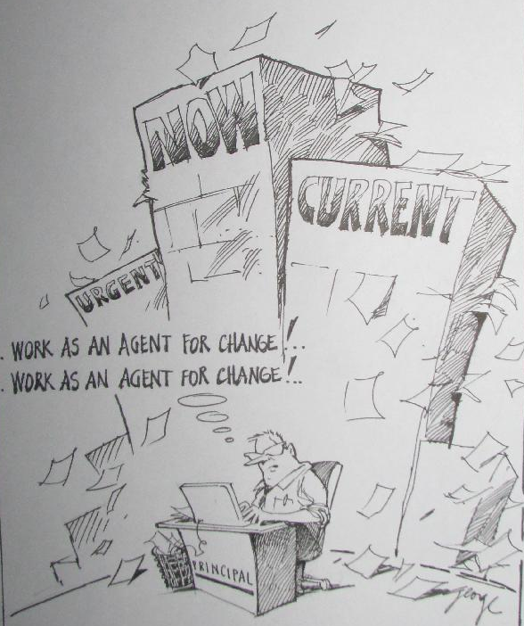
Notes:
Goals are pursued along with business as usual and surprises
Conquer the drivers of goal proliferation
3-4 goals only
How many goals?

Slide 23
Student-Centred Leadership: Dimension Two
1. Establishing Goals and Expectation
1. Ask: What is the problem for which this innovation / resource is supposed to be the solution?
Practise strategic thinking
2. Ask: What assumptions are we making about the link between the problem and the proposed solution?
3. Ask: Where are we currently doing this type of work? Who is already responsible for this?
2. Resourcing Strategically
3. Ensuring Quality Teaching
4. Leading Teacher Learning and Development
5. Ensuring an Orderly & Safe Environment
Notes:
Make point about principals’ assumptions about rather than inquiry into the causal links between preferred programmes/ initiatives and student outcomes

Slide 24

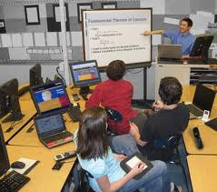
Student-Centred Leadership: Dimension Three
1. Establishing Goals and Expectations
Focus on
Teaching quality –
the biggest source of school-based variance in achievement
2. Resourcing Strategically
3. Ensuring Quality Teaching
4. Leading Teacher Learning and Development
5. Ensuring an Orderly and Safe Environment
Notes:
Replace picture with one of teachers interacting with students and materials

Slide 25
A Defensible Theory of Effective Teaching?
Two Indefensible Approaches:
Style-based approaches
Results-based approaches
Assessment results
How do you attribute them to a single teacher?
Should you?
Preferred teaching techniques/approaches
Preferred personal traits

Slide 26

A More Defensible Theory of Effective Teaching
Effective teaching maximises the time that learners are engaged with and successful in the learning of important outcomes

Slide 27
Leaders’ Inquiry about the Quality of Teaching
The importance of the outcomes being pursued
What are the intended learning outcomes for this lesson/unit of work? Why are they important for these students at this time?

Slide 28
Leader’s Inquiry into the Quality of Teaching
Alignment of the activities and resources with the outcomes
How are these resources/ activities intended to help the students achieve the intended outcomes?

Slide 29
Leader’s Inquiry into the Quality of Teaching
The behavioural and cognitive engagement of students
How well were the students focused on the big ideas in the lesson?

Slide 30
Leader’s Inquiry into the Quality of Teaching
The students’ success on the outcomes
What information do you have about how the students understood the big ideas? What are their remaining misunderstandings?

Slide 31
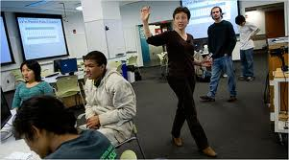

Student-Centred Leadership: Dimension Four
1. Establishing Goals and Expectation
2. Resourcing Strategically
3. Ensuring Quality Teaching
4. Leading Teacher Learning and Development
Leadership that not only promotes
but directly participates with
teachers in formal or informal
professional learning
5. Ensuring an Orderly & Supportive Environment

Slide 32
Student-Centred Leadership: Dimension Four
1. Establishing Goals and Expectation
Focus on the links between what is taught and what students have learned
Use expertise external to group
2. Resourcing Strategically
3. Ensuring Quality Teaching
TPL&D
4 Leading Teacher Learning and Development
Ensure worthwhile evidence-based content
Voluntary or compulsory?
5. Ensuring an Orderly & Supportive Environment

Slide 33
Student-Centred Leadership: Dimension Four
1. Establishing Goals and Expectation
Why is this Dimension so Powerful?
Symbolic importance
Increased leadership expertise brings increased influence
Increased understanding of the conditions required to achieve improvement goals
2. Resourcing Strategically
3. Ensuring Quality Teaching
4 Leading Teacher Learning and Development
5. Ensuring an Orderly & Supportive Environment

Slide 34
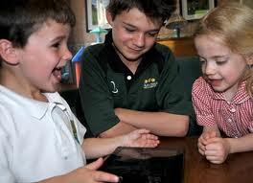
Student-Centred Leadership: Dimension Five
1. Establishing Goals and Expectation
2. Resourcing Strategically
3. Ensuring Quality Teaching
4. Leading Teacher Learning
5. Ensuring an Orderly & Safe Environment

Slide 35
Student-Centred Leadership: Dimension Five
1. Establishing Goals and Expectation
Norms and routines that support
cognitive and behavioural engagement
Relationships of mutual trust
between leaders, staff, parents and students
2. Resourcing Strategically
3. Ensuring Quality Teaching
4. Leading Teacher Learning
5. Ensuring an Orderly & Safe Environment

Slide 36

Student-Centred Leadership: Dimension Five
1. Establishing Goals and Expectation
Protecting time for teaching and learning by:
2. Resourcing Strategically
reducing external
pressures and
interruptions
establishing an orderly
and safe
environment both inside
and outside classrooms.
3. Ensuring Quality Teaching
4. Leading Teacher Learning
5. Ensuring an Orderly & Safe Environment

Slide 37
Exercise 2: Implications for your Own Work
To what extent does the system in which you work support and require student-centered leadership?
What are the barriers you see to stronger student-centered leadership in your school?
How can you contribute to overcoming these barriers?

Slide 38
Integrating educational knowledge into practice
Leadership capabilities
Solving complex problems
Building relational trust
High quality teaching and learning
Leadership dimensions
Establishing goals and expectations
Resourcing strategically
Ensuring quality teaching
Leading teacher learning and development
Ensuring an orderly and safe environment

Slide 39
Three Key Capabilities for Student-Centered Leadership
Integrate Knowledge
Problem solving
STUDENT-CENTERED LEADERSHIP
Relational trust
Viviane Robinson, The University of Auckland
Notes:
Ask Claire S how to put the 5 dimensions in the inner circle. Some principals saw this diagram as a job description.
To put it in its simplest terms, effective instructional leadership requires leaders to be knowledgeable about how to align administrative procedures and processes to important learning outcomes, to be highly skilled in using their knowledge to solve the myriad of problems that arise in the course of improving learning and teaching in their own contexts, and to use their knowledge, their problem solving ability and their interpersonal skills in ways that build relational trust in their school community.
The above summary of the three leadership capabilities has been deliberately expressed in ways that capture their interrelationships. While each capability was discussed separately, and the evidence on which it rested did not test their additive or interactive effects, the theory that informed each made clear the overlaps and interdependencies between them. For example, the capacity to solve problems is deeply enmeshed in the depth and organisation of leaders’ relevant knowledge. Expert problem-solvers use their knowledge of underlying principles and theory to connect the surface features of a problem to underlying patterns and principles. It is these patterns and principles, rather than the details of the problem’s description that provide the clues to its solution.
There are further interdependencies between problem solving and building relational trust because school leaders typically solve problems through social rather than individual processes. Many of the skills associated with expert problem-solving, such as actively seeking others’ interpretations and openly disclosing own views (Table 4) are precisely the skills that Bryk and Schneider associate with interpersonal respect (Figure 2). Educational leaders build relational trust, in part, through respectful and inclusive problem-solving processes.

Slide 40
Building relational trust
Determinants of
Relational Trust
Consequences of High Relational Trust
for teachers
and schools…
for students…
Interpersonally
respectful
Positive attitude to
innovation and risk
Improving
academic
outcomes in
high trust schools
Relational
Trust
Personal regard
for others
More
outreach to parents
Higher likelihood
of positive
social outcomes
Competent in role
Enhanced
commitment
Personal integrity
Enhanced
professional community
Viviane Robinson, The University of Auckland
Notes:
Thinking Schools – Learning Nation – cant have a Thinking school without teachers trusting they can communicate difficulties, give their boss respectful negative feedback and your boss knowing how to inquire into rather than rebut or ignore your views. Feedback that moves both up and down the hierarchy where respect and truth seeking are guiding values are essential.

Slide 41
Open to Learning
Conversations
OLC
VALUES
Respect for self & others
Valid information
Internal commitment
State your point of view
State the grounds for your point of view
Inquire
- Their reactions?
- Their own thoughts?
Evaluate/ critique thinking
Establish common ground
Make a plan
Paraphrase and check understanding
Viviane Robinson, The University of Auckland
Notes:
In the remainder of this module I outline the components of an open to learning conversation. The components are not steps that are inevitably followed in a strict sequence – conversations vary enormously and can not be scripted in advance. If you understand and practise these components, however, you are much more likely to craft conversations that are open to learning rather than controlling and closed to learning.

Slide 42
Complex problem solving
Complex problem solving involves discerning relevant constraints and modifying and integrating them in ways that enable a solution to be reached
The goal
Discern relevant constraints
Modify/ integrate
Enables solution
Viviane Robinson, The University of Auckland

Slide 43
Complex problem solving
Complex problem solving
Expert principals
are more likely to:
Typical principals
are more likely to:
Carefully plan a collaborative problem-solving process
Do less planning of the process
Openly disclose own views without foreclosing or restraining other views
Not disclose own view or disclose in a controlling manner
Overtly manage meeting process e.g., summarising and synthesising staff views
Do less active meeting management
Experience and express little or no negative emotion and frustration
Experience unexpressed negative emotion and frustration
Viviane Robinson, The University of Auckland

Slide 44
Integrate knowledge of teaching and learning
Goal:
to improve the educational quality of homework
Required shift in teaching:
from drill and practice homework to interactive homework
Administrative shifts required to support shift in teaching:
?
Viviane Robinson, The University of Auckland

Slide 45

Suggested Reading
Robinson, Viviane (2011).
Student-centered leadership.
San Francisco: Jossey Bass.
Robinson, V. M. J. (2007). School leadership and student
outcomes: Identifying what works and why.
The University of Auckland Centre for Educational Leadership:
Monograph & Resource Pack (available from www.education.auckland.ac.nz/uacel)
Robinson, V. M. J. & Timperley, H. S. (2007). The leadership of the improvement of teaching and learning: Lessons from initiatives with positive outcomes for students. Australian Journal of Education, 51 (3), 247-26.

Slide 46
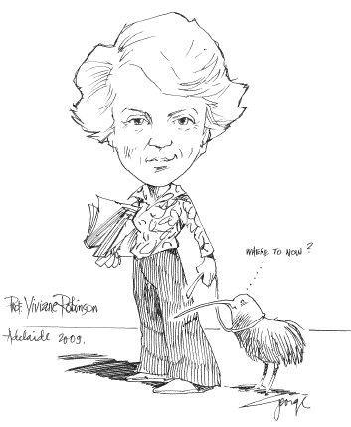
Thank you for your participation today

