Slide 1
YESTERDAY is a history. TOMORROW is a mystery. TODAY is a gift. This is the reason why you call it present.

Slide 2
iLead-serve.
iTransform.
iChange.
A Plenary Session Presentation on Educational Leadership Challenges
(Republic of the Philippines)
Academy of Principals -
4th Global Education Conference
12 July 2012
ERICO MEMIJE HABIJAN
PRESIDENT, NATIONAL ORGANIZATION OF PROFESSIONAL TEACHERS; IPPRESIDENT, PHILIPPINE SCHOOL PRINCIPALS ASSOCIATION
Chief, Dep Ed. (CALABARZON) Basic Education

Slide 3
KEY WORDS:
Leadership
CHANGE
(Education Agenda)
Transform
(Governance)
Philippine Education System

Slide 4
Our Problems. Our Issues. Our Concerns .
Uncompetitive basic education cycle
(The Philippines is the only remaining country in Asia with a 10 – year basic education program.)
Insufficient mastery of basic competencies due to congested curriculum
(The poor quality of Philippine basic education is reflected in the low achievement scores of Filipino students.)
Lack of basic skills and maturity among our high school graduates (16 years old)
(Our HS graduates are inadequately prepared for the world of work, entrepreneurship or higher education).

Slide 5
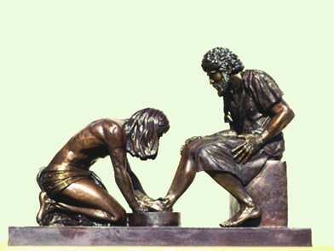
From the Church:
In the article written by Rev. Fr. Antonio Cecilio T. Pascual (2011), Everyone a Public Servant, A Suffering Servant, he said that:
Now, our Lord presents Himself to us as the Suffering Servant once again, in a politicized country that boasts of leaders – public servants, all – from national to local officials, from “imperial Manila” down to the “purok or barangay”

Slide 6
From our Learners:
“One leader is not enough for the change we seek. Each of us must learn how to lead ourselves for the greater good (Jenn Besonia, PUP, 2011).”
“It is important for the leader to pursue excellence in school, with the intention of serving the country. It is crucial that whatever they learn, they should apply” (Alyssa Fermin, UP Manila, 2011).”
“The leader can offer a fresh perspective on how to efficiently run the government. More than just airing their concerns and grievances, leader should at the forefront, championing their advocacies. (Ranel Ram Cheng, UP Diliman, 2011).”

Slide 7
From a Researcher:
In the discussion paper presented by Dr. Sheldon Shaeffer (2012), entitled
Better School Leadership:
Transforming the Education System
(1st Education Lecture in Memory
of Victor M. Ordonez)
He considered the following provocations:

Slide 8
The 10 Provocations
Does the education system in the Philippines worry enough about the Net NON-Enrolment Rate? Does it accurately measure what this rate is?
Do schools in the Philippines pay attention only to their own students, or do they also care about children not in school – and try to get them enrolled?
Do they work proactively to reduce disparities in enrolment and achievement caused by gender, disability, poverty, and ethnicity?

Slide 9
Why are children often forced to adapt to the needs of the school rather than the school adapting to the needs of each child?
Does the education system understand and adequately satisfy the educational and development needs of children aged 0-8 – when the foundations for quality learning are laid?
Why do schools often assign the least experienced and/or trained teacher to Grade 1 and tolerate the highest pupil-teacher ratio in that grade? (And why is Grade 6 the opposite?)

Slide 10
Why do many principals feel more accountable UP the system to DepED rather than OUT to the children and families they serve?
Why do we use the word “drop-out” when most “drop-outs” are usually “push-outs” from school?
Why do schools often push out “bad” students but rarely bad teachers?
Why do so many students fail to learn? Who is to blame for their failure – the children and their families or the education system and the school?

Slide 11
THE PROVOCATIONS’ SUMMARY AND PERSPECTIVE
EDUCATIONAL
SYSTEM
IN THE PHILIPPINES
ACHIEVEMENT
ATTAINMENT
ATTENDANCE
ACCESS

Slide 12
Leadership and Governance Map
“If you don’t know where you are going, any road will get you there.”
Lewis Carroll, 1898
Leadership Map is fundamentally about discovering what works and what doesn’t. It is an attempt to provide a map of one’s leadership and governance that can allow leaders to determine not only their target for achievement, but how to achieve it and what results indicator can assure them that they are on a right path.

Slide 13
VISION: By 2030, DepEd is globally recognized for good governance and for developing functionally-literate and God-loving Filipinos.
MANDATED BY:
Philippine Constitution
Education Act of 1982
Governance Act of Basic Education (RA9155)
MISSION:
To provide quality basic education that is accessible to all and lays the foundation of lifelong learning and service for the common good.
FUNCTIONAL LITERACY
GOOD GOVERNANCE
Learners become functionally-literate
CONSTITUENCY
Access to learner-centered opportunities suitable for diverse needs
Philippines
PROCESS EXCELLENCE
Strengthen learner-centered teaching process
Practice participative and inclusive management process
PEOPLE
Demonstrate professional and ethical standards and best practices to optimize personnel productivity
CORE VALUES:
Culture of Excellence, Integrity and Accountability
Maka-Diyos (Pro-Christ)
Makatao (Pro-People)
Makabayan (Pro-Philippines)
Makakalikasan (Pro-Environment)
Ensure efficient and effective use of resources
RESOURCES
Allocate resources equitably
Increase resource base to a level that is at par with global standards
STAKEHOLDER PARTICIPATION
Strengthen and expand stakeholder convergence mechanisms at all levels

Slide 14
BE GLOBALLY
COMPETITIVE
-Basic Education
K TO 12 EDUCATION VISION
Philippine Education Program
THE ANSWER
BE LEGALLY EMPLOYABLE
WITH POTENTIAL FOR BETTER EARNINGS
- Legally Employed
BE ADEQUATELY PREPARED FOR THE WORLD OF WORK, ENTREPRENEURSHIP, OR HIGHER EDUCATION
- Work vs. Tertiary Education
BE SOCIALLY AWARE, PRO-ACTIVE, INVOLVED IN PUBLIC AND CIVIC AFFAIRS
– Values and Virtues
BE MORE EMOTIONALLY MATURE
- Emotion vs Decision
ACQUIRE MASTERY OF BASIC COMPETENCIES – the truth

Slide 15
LEADERSHIP
GOVERNANCE
LEARNER-CENTERED
NATION BUILDING AND DEVELOPMENT

Slide 16
ERGO… The Role of the School Leaders
School leaders, supported by Regional Directors and Superintendents, need to ensure that ALL STAKEHOLDERS:
take part in decisions affecting their professional lives and teaching environments
understand diversity in learning styles and in the development of their students
create stimulating learning environments – participatory and child-centred
accept their professional responsibilities and be accountable to both learners and communities
make schools healthy, safe, and protective – both physically and psycho-socially
become “reflective practitioners”

Slide 17
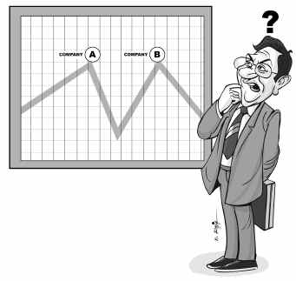
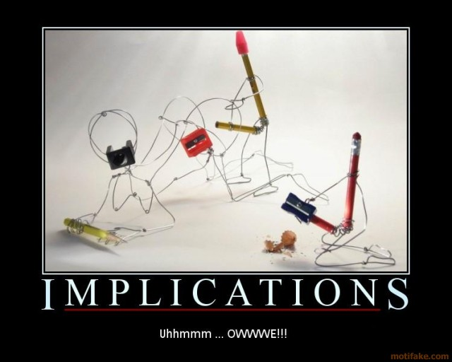
and

Slide 18
SBM –TL/BL Framework
Self as Transformational Leader
OWNERSHIP
CO-OWNERSHIP
CO-CREATION
School Leadership
Instructional Leadership
Empowered Citizenry
Personal & Professional Attributes & Interpersonal Effectiveness
Engagement Mechanisms
Situational Mastery
Culture of EXCELLENCE, CREATIVITY, ACCOUNTABILITYMAKA-DIYOS, MAKA-TAO, MAKABAYAN AT
MAKA-KALIKASAN
Creating a Student-Centered Learning Climate
Multi-stakeholder processes
(Convening & Trust Building Dialogues)
Personal
Response
VMOKRAPI
Shared
VMOKRAPI
New Institutional Arrangements
Social Innovations (Programs & Services)
School Management and Operations
Educational Issue
Quality Graduates
Parent Involvement and Community Partnership
Societal Transformation
Human Resource Management and Professional Development
Stakeholder Analysis
New Relationships among Stakeholders
Responsive Institutions
Transformational Leadership

Slide 19
Implementation of the
School -Based Management Practice
TRANSFORMATIONAL
& BRIDGING LEADERSHIP
- SIP-AIP
-SIP-AIP Appraisal
PERFORMANCE MANAGEMENT
INSTRUCTIONAL
LEADERSHIP
For SHs:
School
Based Management
Teacher-In-Charge
Officer-In-Charge
Head Teachers
Principals

Slide 20
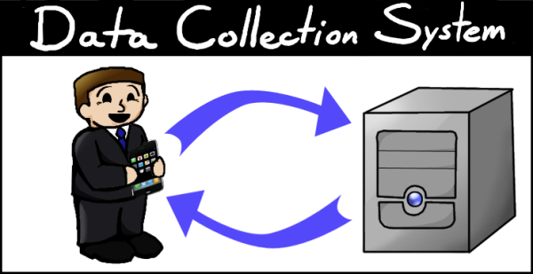
IMPLICATIONS . . . IMPLICATIONS . . . IMPLICATIONS!
KNOW YOUR DATA;
THE DATA MUST HAVE MEANING
“KNOW THE STORY BEHIND HISTORY”
(EXCELLENT HISTORY, EXCELLENT STORY)

Slide 21
CHANGE
o
360 - Turn Around

Slide 22
“360*” IMPLIES … Identify Element 0
?
0% - Non-Reader
0% - Illiterate
0% - Repeater/Drop-out
0% - Negative Performance
o
Target: Education for All 2015
Source DepEd

Slide 23
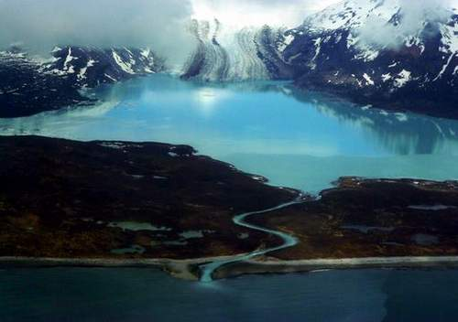
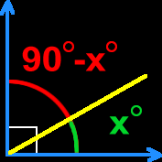
TO RESPECT
VS
TO UNDERSTAND
. . . Be lke
COMPLEMENTARY ANGLES

Slide 24
“COMMUNION”
to commune with
MEANS
WORKING TOGETHER;
TO BE WITH

Slide 25
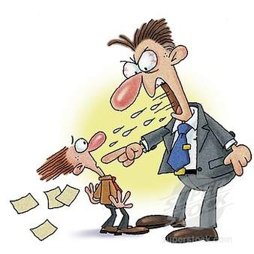
WHO
IS
YOUR REAL
BOSS?
(THE LEARNERS)

Slide 26
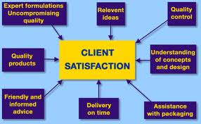
HAVE POSITIVE RESULTS:
improved: PERFORMANCE INDICATORS

Slide 27
LEARN NOT ONLY FROM POSITIVE THINGS,
BUT ALSO
FROM ITS INVERSE
(positive and negative )
Change our Vocabulary!

Slide 28
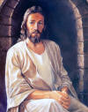
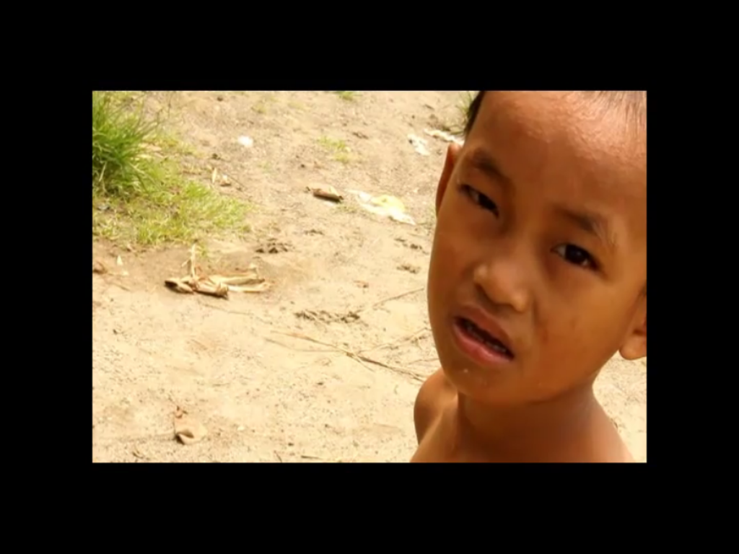
I’ll Do it For You
B. Adams
Look into my eyes - you will see
What you mean to me
Search your heart - search your soul
And when you find me there you'll search no more

Slide 29
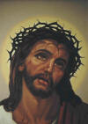
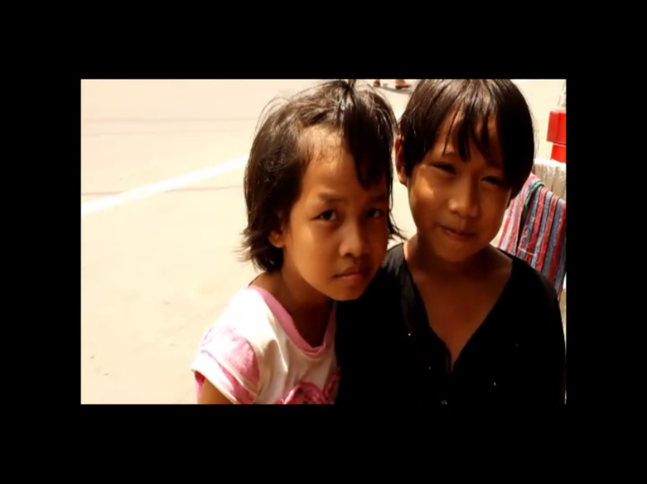
Don't tell me it's not worth tryin' for
You can't tell me it's not worth dyin' for
You know it's true Everything I do - I do it for you

Slide 30
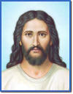
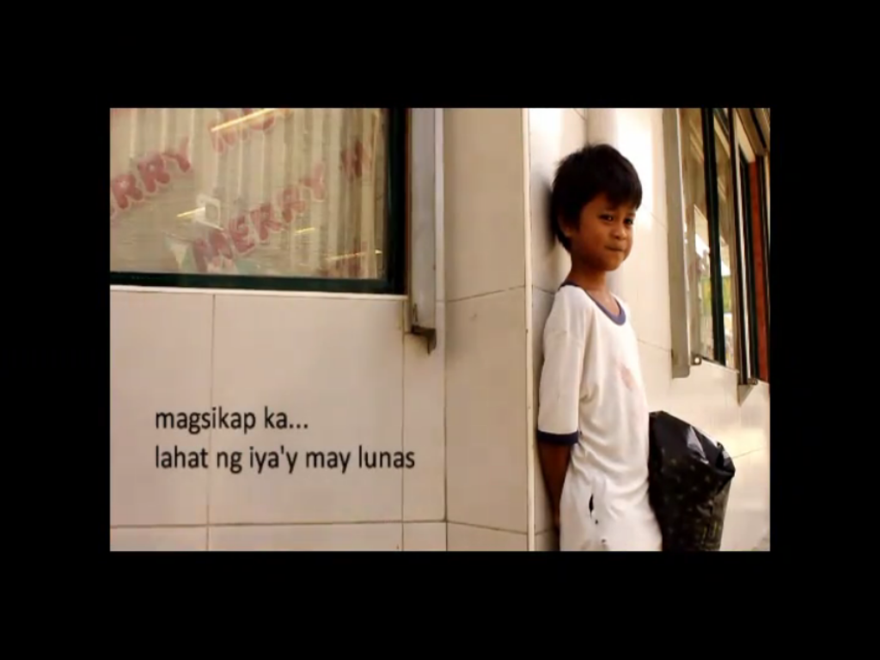
Look into your heart - you will find
There's nothin' there to hide Take me as I am - take my life I would give it all - I would sacrifice

Slide 31
Don't tell me it's not worth fightin' for
I can't help it - there's nothin' I want more
Ya know it's true
Everything I do,
I do it for you.

Slide 32
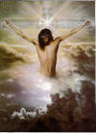
There's no love - like your love
And no other - could give more love
There's nowhere - unless you're there
All the time - all the way

Slide 33
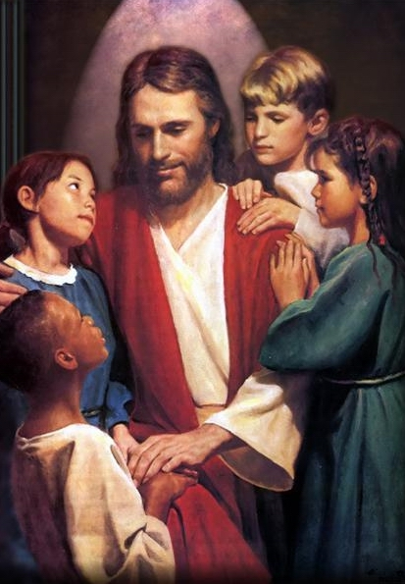
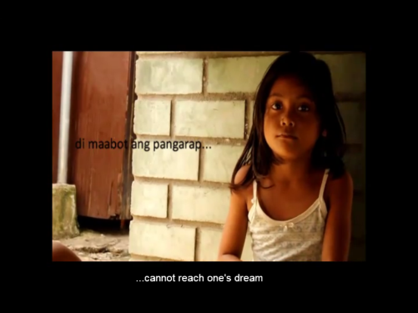
Oh - you can't tell me it's not worth tryin' for I can't help it - there's nothin' I want more I would fight for you - I'd lie for you Walk the wire for you - ya I'd die for you Ya know it's true Everything I do - I do it for you

